Slide 1

Ahmednagar Jilha Maratha Vidya Prasarak Samaj’s Shri Chhatrapati Shivaji Maharaj College of Engineering, Nepti, Ahmednagar
A Blockchain-Based Decentralized Marketplace
for Trustworthy Trade
Presented by: Guided By:
.
.
YOGESH SONAWANE
VAISHNAVI BARDE
PAWAR MAHESH
SANSARE JAYSHREE
Prof. KOHAKADE P.S.

Slide 2
CONTENTS
Introduction
Literature survey
Objectives of proposed system
Motivation
Difference between proposed and existing system.
Introduction of proposed system
Architecture of proposed system
Modules
Mathematical Model
UML Diagram
Application
Conclusion
References

Slide 3
INTRODUCTION
Blockchain
Reverse circle cipher
Smart Contract
Trustless Data Trading Mechanisms

Slide 4
LITERATURE SURVAY
Paper | Author | Problem Discussed | Algorithm | Advantages/Limitations | Journal Conference
MedRec: Using Blockchain for Medical Data Access and Permission Management | Asaph Azaria, Ariel Ekblaw, Thiago Vieira and Andrew Lippman | present MedRec, a blockchain-based large scale data management of the EMR system. MedRec provides patients a log of his/her medical history, which is not only inclusive but also credible and accessible. | MedRec | Providers can attach a fresh record related to a specific patient, and patients can allow the sharing of information amongst providers. | 2nd International Conference on Open and Big Data (OBD), IEEE, 22 Sep 2016.

Slide 5
LITERATURE SURVAY
Paper | Author | Problem Discussed | Algorithm | Advantages/Limitations | Journal Conference
Automatic Hopping Among Pools And Distributed Applications In The Bitcoin Network | Juan José García Chávez and Carlo Kleber da Silva Rodrigues | proposed an algorithm which authorizes to find out the moments of bad luck beside the right moment to hop between mining pools in the Bitcoin network. The algorithm takes into account the collected statistical data and generated during the online operation. | Bitcoin Mining Pool | The process defined as kind-of pool supervision that enables one to find out when the pool is in moments of bad luck | XXI Symposium on Signal Processing, Images and Artificial Vision (STSIVA), IEEE, 17 Nov 2016.

Slide 6
LITERATURE SURVAY
Paper | Author | Problem Discussed | Algorithm | Advantages/Limitations | Journal Conference
A Proposal of a Secure P2P-Type Storage Scheme by Using the Secret Sharing and the Blockchain | Masayuki Fukumitsu , Shingo Hasegawa , Junya Iwazaki , Masao Sakai and Daiki Takahashi | proposed a novel technique for hiding the metadata itself in the P2P network. In the proposed scheme, the metadata is encrypted and divided into some shares, and then they are distributed to the seemingly random selected P2P nodes | P2P network, Metadata | The blockchain technology is used to record a time history of storage node lists because it needed to share with P2P nodes certainly. | IEEE 31st International Conference on Advanced Information Networking and Applications (AINA) , 08 May, 2017.

Slide 7
Objective of proposed system
To study the signature creation process
To evaluate the security of the resultant system based on Blockchain and Artificial Intelligence
To make sure the system is efficient and tamper-proof for the process of access control mechanism

Slide 8
Motivation
Increasing Trust between the data entities and Data vendors
Enabling strict access control policies for Data requestors
Respective smart contracts on all scenarios of Distributed Data Vending

Slide 9
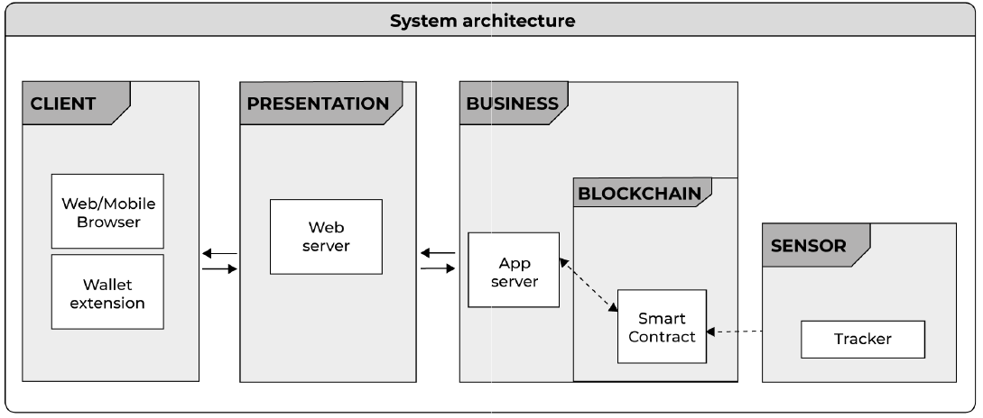
Existing System

Slide 10
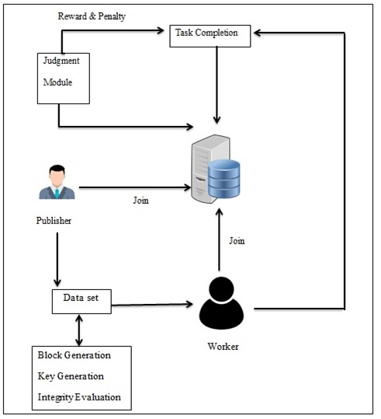
Proposed System

Slide 11
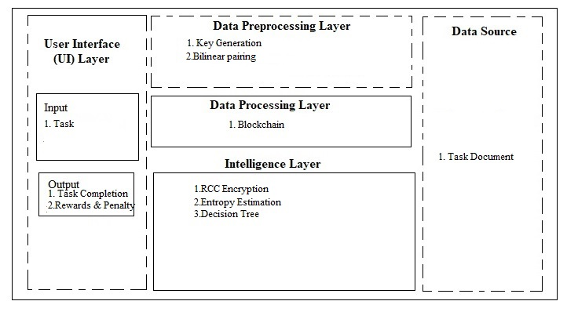
System Architecture

Slide 12
Modules
Data Storage
Encryption
Blockchain Formation
Data Integrity
Access Control
Reward and Penalty Scheme

Slide 13
Mathematical Model
S= { } be as system for Blockchain based Decentralized framework
Identify Input as T={ T₁, T₂, T₃…. T_{n}}
Where T= Task
S= { T_{n}}
Identify T_{C} and R_{P} as Output i.e. Task Completion , Rewards & Penalty
S= { T_{n}, T_{C} , R_{P} }
Identify Process P
S= { T_{n}, P, T_{C} , R_{P} }
P= { R_{CC}, B, E_{E},D_{T}}
Where,
R_{CC} =Reverse Circle Cipher
B=Blockchain
E_{E}=Entropy Estimation
D_{T}=Decision Tree
So the final System can be defined as
S = { T_{n}, R_{CC}, B, E_{E},D_{T}, T_{C} , R_{P} }

Slide 14
Mathematical Model (cont.)
SET DESCRIPTION:
Reverse Circle Cipher
Set R_{CC}:
R_{CC0}= Data List
R_{CC1}= Block formation
R_{CC2}=Block Rotation
R_{CC3}= Byte Replacement
Blockchain
Set B:
B₀=Encrypted String
B₁=Hash Key Generation
B₂=Random Character Selection
B₃= Block Chain Formation

Slide 15
Mathematical Model (cont.)
Entropy Estimation
Set E_{E}:
E_{E0}=Gain Index
E_{E1}= Gain Ration
E_{E2}=Logarithmic Ratio
E_{E3}=Entropy List
Decision Tree
Set D_{T}:
D_{T0}=Protocol Setting
D_{T1}=Gain Factor Analysis
D_{T2}=IF-then Rules
D_{T3}=Decision Analysis

Slide 16
Mathematical Model (cont.)
Representation of Sets and its operation:-
Union Representation:-
Set R_{CC=}{ R_{CC0,} R_{CC1,} R_{CC2,} R_{CC3}}
Set B ={ B_{0,} B_{1,} B_{2,} B₃}
Set (R_{SA} U B) = { R_{CC0,} R_{CC1,} R_{CC2,} R_{CC3} U B_{0,} B_{1,} B_{2,} B₃}
Set E_{E} ={ E_{E 0,} E_{E1,} E_{E2,} E_{E 3}}
Set (R_{SA} U B U E_{E} ) = { R_{CC0,} R_{CC1,} R_{CC2,} R_{CC3}, B_{0,} B_{1,} B_{2,} B₃ U E_{E 0,} E_{E1,} E_{E2,} E_{E 3}}
Set D_{T} ={ D_{T 0,} D_{T1,} D_{T2,} D_{T 3}}
Set (R_{SA} U B U E_{E} U D_{T}) = { R_{CC0,} R_{CC1,} R_{CC2,} R_{CC3}, B_{0,} B_{1,} B_{2,} B₃ , E_{E 0,} E_{E1,} E_{E2,} E_{E 3} U D_{T 0,} D_{T1,} D_{T2,} D_{T 3}}

Slide 17
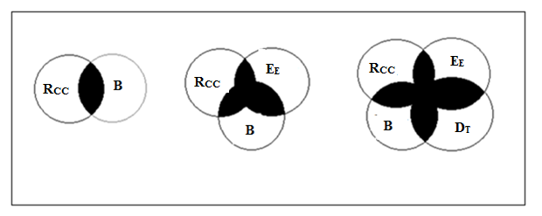
Mathematical Model (cont.)
Venn diagram:

Slide 18
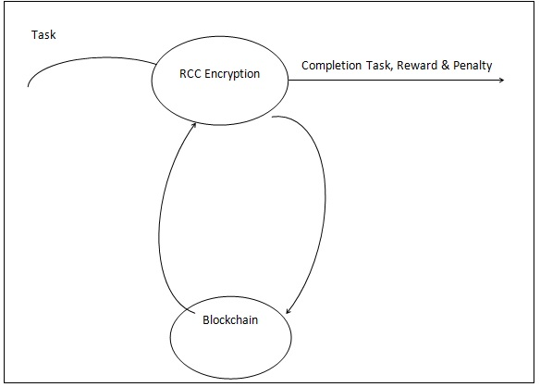
DFD 0

Slide 19
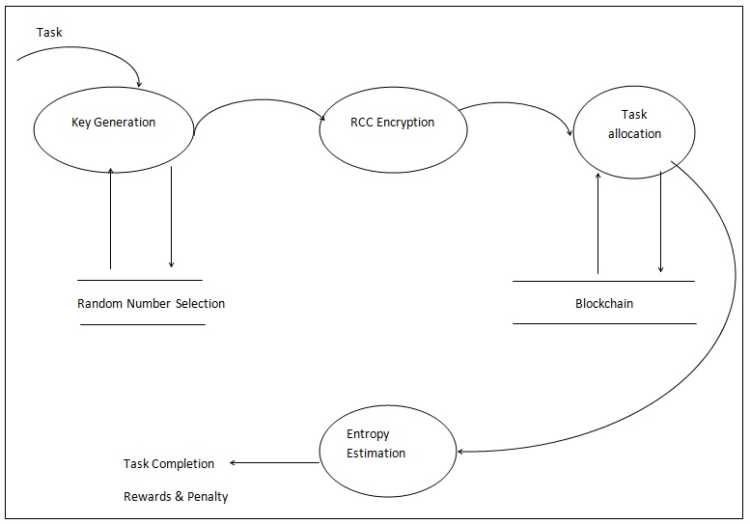
DFD 1

Slide 20
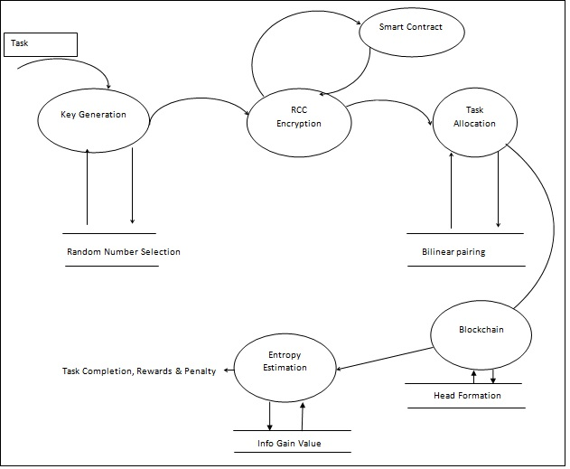
DFD 2

Slide 21
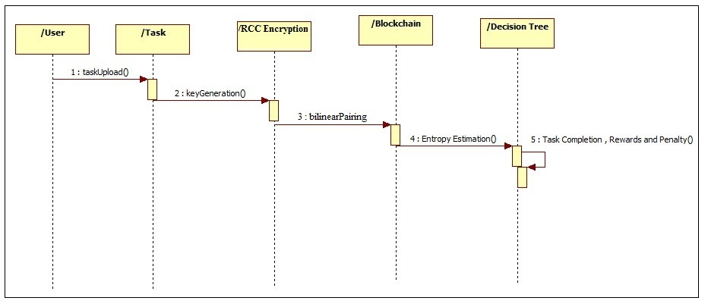
Sequence Diagram

Slide 22

Activity Diagram

Slide 23
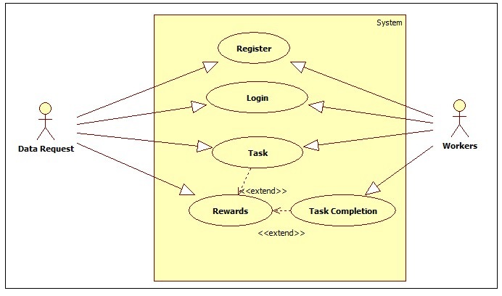
Use Case Diagram

Slide 24
Requirements Software and Hardware
HARDWARE REQUIREMENTS:
System : Intel i5.
Hard Disk : 500 GB.
Monitor : 15 VGA Color.
Mouse : Logitech.
Ram : 8 GB.
SOFTWARE REQUIREMENTS:
Operating system : Windows XP Professional/7LINUX.
Coding language : JAVA
IDE : NetBeans 8.2
Database : MySQL

Slide 25
Applications
Crowdsourcing applications
Health care
Banking, Job Consultancy, Government agencies

Slide 26
Conclusion
Efficient Block making
Efficient Access Control
Successful Data Vending
Maintaining Trust less Data vending scenario in effortless manner

Slide 27
References
[1] Asaph Azaria, Ariel Ekblaw, Thiago Vieira and Andrew Lippman, “MedRec: Using Blockchain for Medical Data Access and Permission Management ”, 2016 2nd International Conference on Open and Big Data (OBD), IEEE, 22 Sep 2016.
[2] Juan José García Chávez and Carlo Kleber da Silva Rodrigues, “Automatic Hopping Among Pools And Distributed Applications In The Bitcoin Network ”, 2016 XXI Symposium on Signal Processing, Images and Artificial Vision (STSIVA), IEEE, 17 Nov 2016.
[3] Masayuki Fukumitsu , Shingo Hasegawa , Junya Iwazaki , Masao Sakai and Daiki Takahashi, “A Proposal of a Secure P2P-Type Storage Scheme by Using the Secret Sharing and the Blockchain ”, 2017 IEEE 31st International Conference on Advanced Information Networking and Applications (AINA) , 08 May, 2017.

Slide 28
THANK YOU

